Slide 1
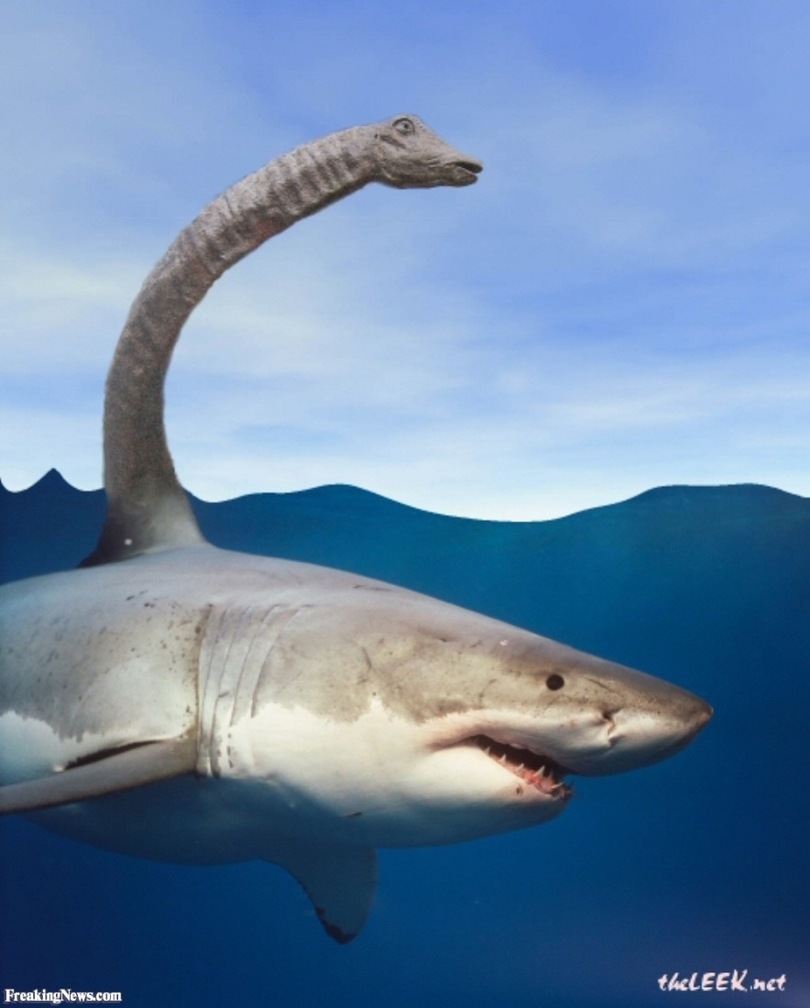
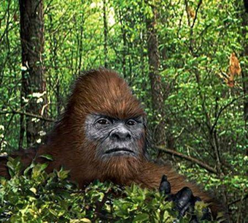
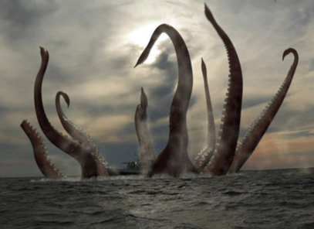
See to believe it.
In search of Nessie…
Module 3 Lesson 3A
By I. Kukushkina

Slide 2
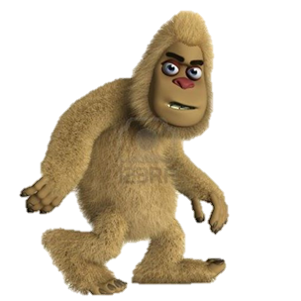
Words to remember
Tentacle – щупальце
Sharp – острый
Hook – крюк
Humped – горбатый
Sightings – наблюдения
Unicorn – единорог
Ancient – древний
Couple – пара (муж и жена, мужчина и женщина)
Horrifying – ужасный
blunt – тупой (о предметах)
Violent – сильный, мощный, жестокий
Whirlpool – водоворот
Bottom – низ, дно
Squid – кальмар
Witness – свидетель, очевидец
Ape – человекообразная обезьяна, примат
Fossil – ископаемое, окаменелость

Slide 3
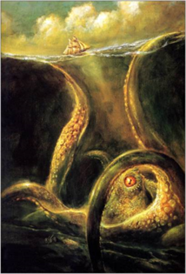
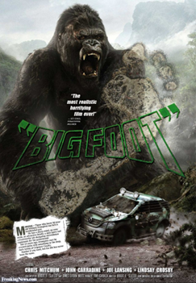
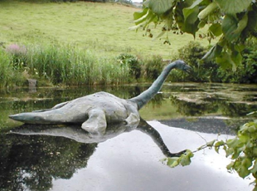

Nessie / Kraken / Bigfoot
.
I knew…
I didn’t know…
I was impressed…

Slide 4
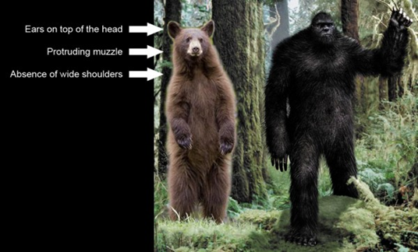
Ex. 2 p. 42 Which creature(s) (A-C)…
B
Live in water? 1. ________ 2. ________
Could be creatures that people
thought had died out? 3. ________ 4. ________
3. Have people been seeing
for longer than you might think? 5. ________
4. Often used to destroy something? 6. ________
5. Have people found the bodies of? 7. ________
A
A
C
A
B
B

Slide 5
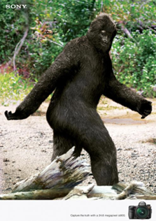
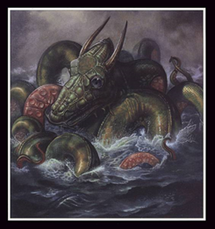
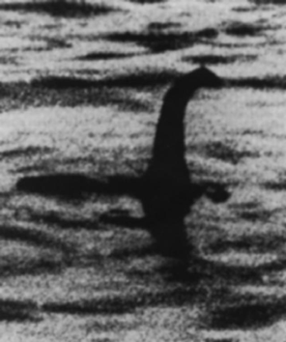
Read the text at pp. 42-43, SB and mark the sentences T (true), F
(false) or NS (not stated).
1. There have been more than three thousand sightings of Bigfoot in America. ___
2. Bigfoot is a kind of an ape. ___
3. It is proved that Nessie is a dinosaur. ___
4. The existence of Kraken is still a mystery. ___
5. There have been over three thousand recorded sightings of Nessie. ___
T
NS
F
F
F

Slide 6
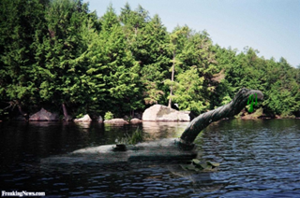
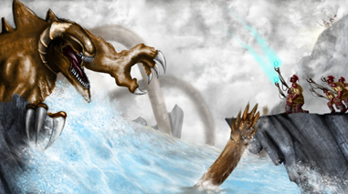
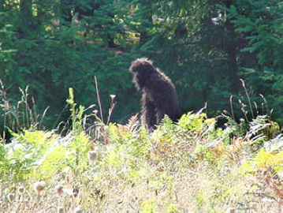
Ex. 3 p. 42 Match the highlighted words and phrases from the text to their meanings.
Report –
Sightings –
Survived –
Horrifying –
Across –
Approached –
Violent –
Off –
So far –
Stayed alive
Came closer
Tell people about
Things that have been seen
Shocking, disgusting
Wide
Until now
With great force
Close to

Slide 7
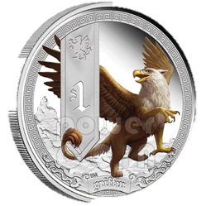
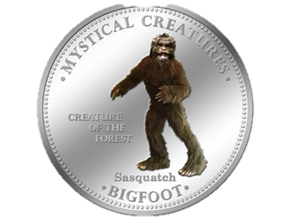
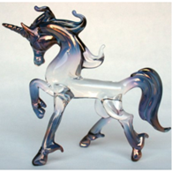
Ex. 4 p. 42 Match the underlined words in the text to their opposites.
Different –
Destroy –
Real –
Unknown –
Top –
Blunt –
Luckily –
Miniature –
Create
Famous
Similar
Mythical
Unfortunately
Bottom
Giant
Sharp

Slide 8
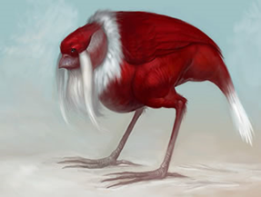
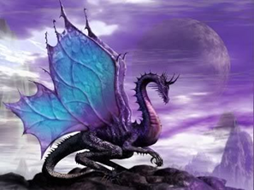
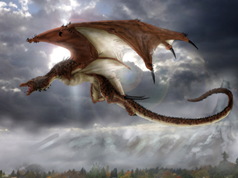
Ex. 5 p. 42 - Fill in: recorded / humped / horrifying / mythical / snake / human / sharp / giant / violent / extinct
mythical
1. _____________ creatures
2. _____________ back
3. _____________ - like head
4. _____________ sightings
5. _____________ squid
6. _____________ whirlpool
7. _____________ hooks
8. _____________ prints
9. _____________ ape
10. ____________ sea monster
humped
snake
recorded
giant
violent
sharp
human
extinct
horrifying

Slide 9
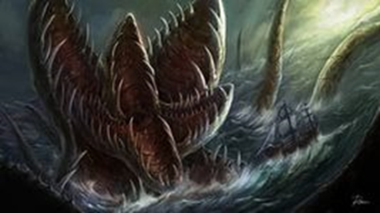
Read definitions of some words from the texts at pp.42-43, SB and decide which word is defined.
Whirlpool
Violent
Ape
Sighting
Squid
1. When you see something or someone, especially that is rare or trying to hide.
2. A small area of the sea or other violent water in which there is a powerful circular current of water which can pull objects down into its centre.
3. A sea animal with a long body and ten arms situated around the mouth.
4. Sudden and powerful.
5. An animal like a large monkey which has no tail and uses its arms to swing through trees.

Slide 10
Complete the sentences using the words from the table in ex. 3. (whirlpool, apes, squids, sighting, violent)
1. This is the first _____________ of this particularly rare bird in this country.
2. I’m scared of _____________ thunderstorms.
3. Chimpanzees and gorillas are both _____________.
4. ______________ are very dangerous: they make the object drown.
5. ______________ are members of the Cephalopoda class.
sighting
violent
apes
Whirlpools
Squids

Slide 11
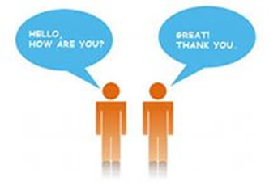
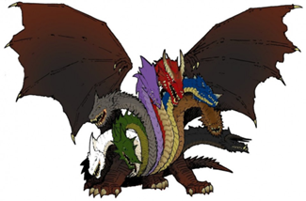
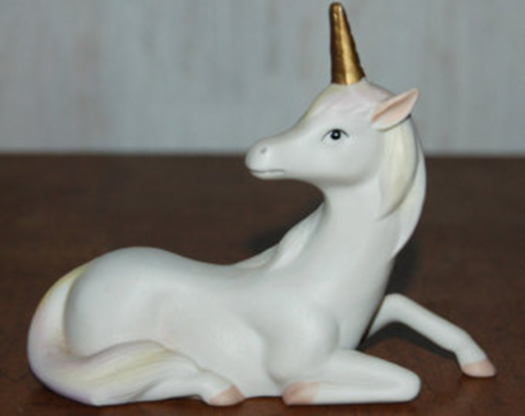
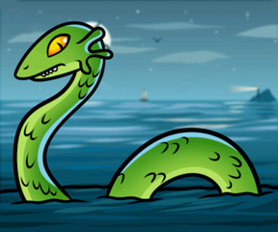
Make the dialogue. Express your opinion about the text. Read the text and choose the facts you were impressed by.
A: What things impressed you most?
B: I was impressed by… . I didn’t know that…. And you?
A: As for me, I…

Slide 12
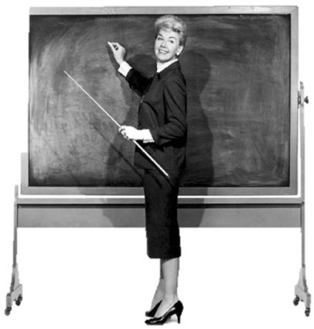

Reflection
Tell which things in the text impressed
you most? Why?
I was impressed by…, because…
H.W.
St.B. p. 43 ex. 8 (Letter)
Learn the words from the lesson

